Slide 1
Storytelling Case Study: Airbnb, NYC
Ranjith cheela
Hien Huynh
Raheema

Slide 2
Objective:
Airbnb is an online platform using which people can rent their unused accommodations.
During the covid time, Airbnb incurred a huge loss in revenue.
People have now started travelling again and Airbnb is aiming to bring up the business again and e ready to provide services to customers.

Slide 3
Background
For the past few months, Airbnb has seen a major decline in revenue.
Now that the restrictions have started lifting and people have started to travel more, Airbnb wants to make sure that it is fully prepared for this change.
So, analysis has been done on a dataset consisting of various Airbnb listings in New York.

Slide 4
Data Preparation
Cleaned data to remove any missing values and duplicates.
Dropped insignificant columns.
Identified outliers

Slide 5
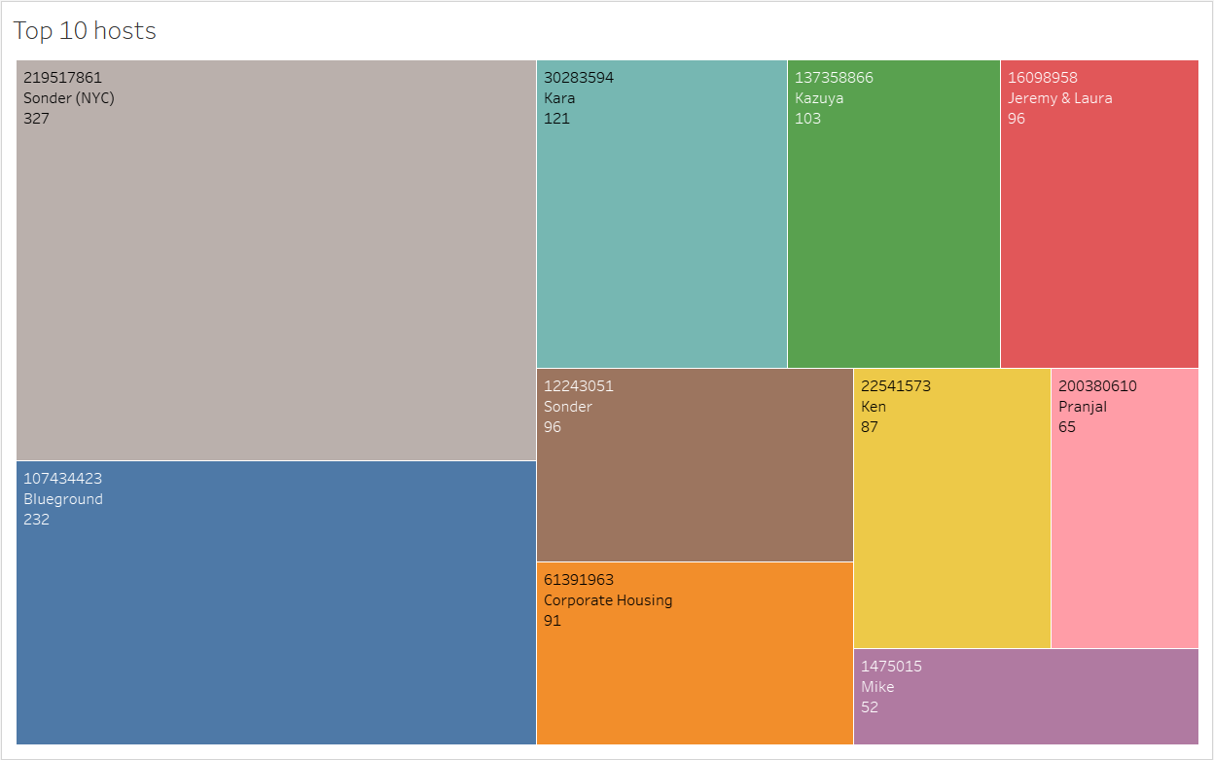
Ten Best Hosts
Host Sonder (id 219517861), has been booked most number of times i.e. 327.
Host Blue ground is the second popular host.
Then there are other hosts like Kara, Ken, Pranjal, Jeremy and Mike that fall under top 10 hosts.

Slide 6
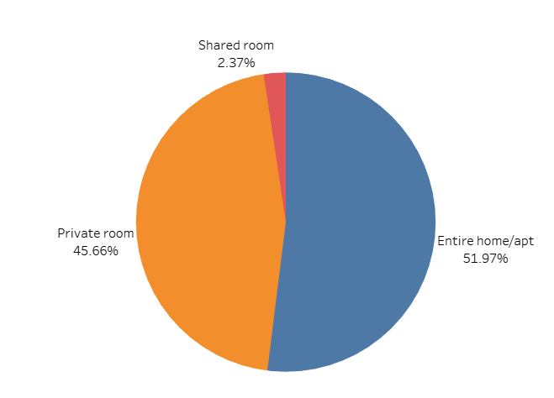
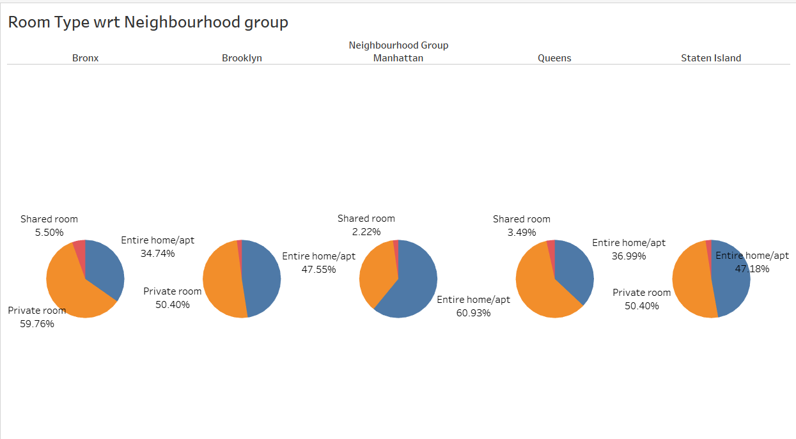
Categories of Rooms
There are three types of rooms - Entire home/Apartment, Private room & shared room.
Overall, customers appear to prefer private rooms (45%) or entire homes (52%) in comparison to shared rooms (2.4%).
Airbnb can concentrate on promoting shared rooms with discounts to increase bookings and also acquire more private listings.
Queens & Bronx contribute 60% each to private rooms, more than the combined ratio of 45% Whereas, Manhattan has a higher contribution in entire home (61%), compared to the combined ratio of 52%.

Slide 7
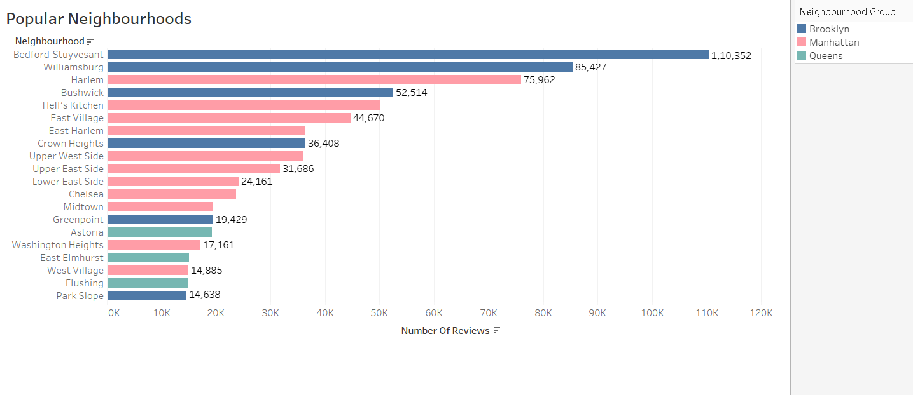
Well-Liked Areas
Bedford-Stuyvesant in Brooklyn has received the most reviews, totaling 110,352, making it the most popular area, followed closely by Williamsburg.
Harlem in Manhattan has garnered the highest number of reviews, with Hell’s Kitchen following behind.
A greater volume of customer reviews suggests greater satisfaction levels in these neighborhoods.

Slide 8
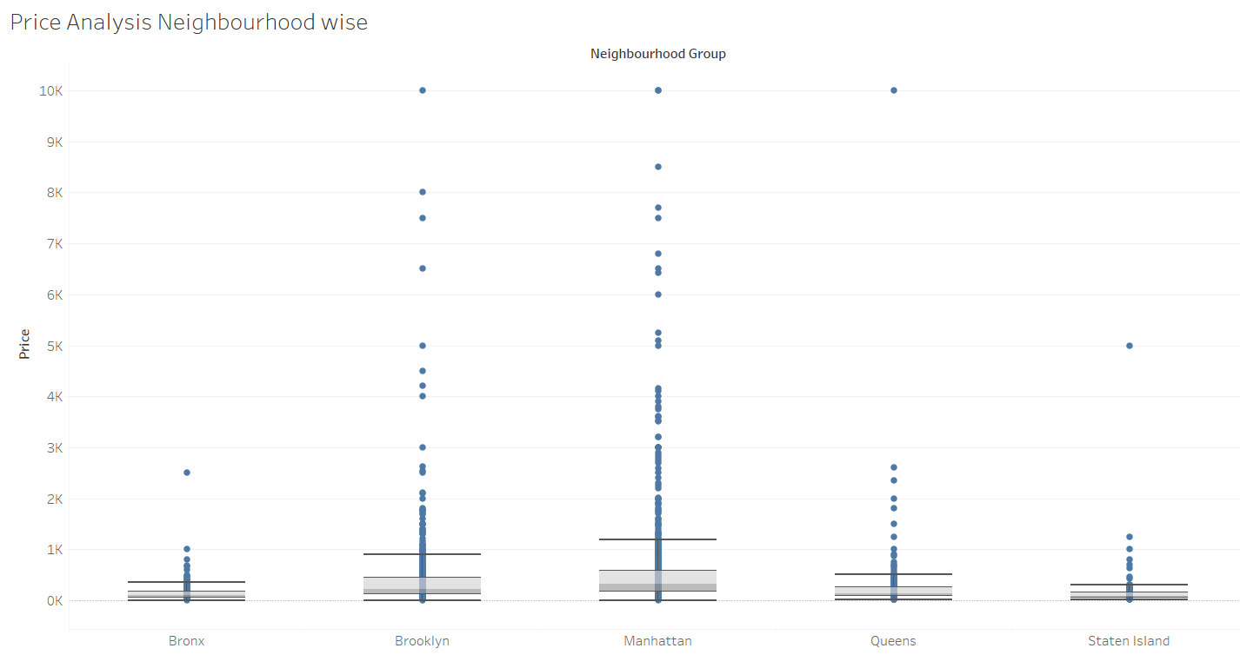
Price Analysis by Neighbourhood
The highest prices were in Manhattan and Brooklyn
Manhattan has the highest listing range
Bronx is the cheapest of them all.
We can see the median price of all neighbourhood groups lying between $ 80 to $ 300.
Price was highly positively skewed so median was very close the lower quartile with some outliers as seen in the boxplot below.

Slide 9
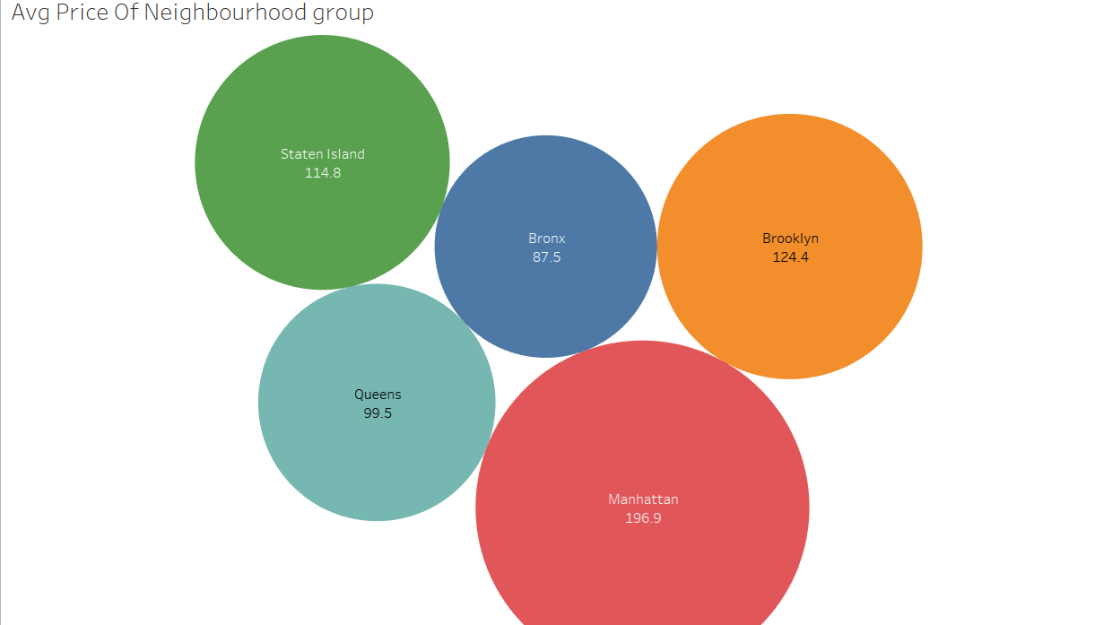
Typical cost of Community clusters
In Manhattan, the average price of listed properties is approximately 196.9, making it the highest among all neighborhoods.
Brooklyn follows as the second most expensive area, with an average price of 124.4.
The Bronx stands out as a more affordable neighborhood, with average prices nearly half of those in Manhattan.

Slide 10
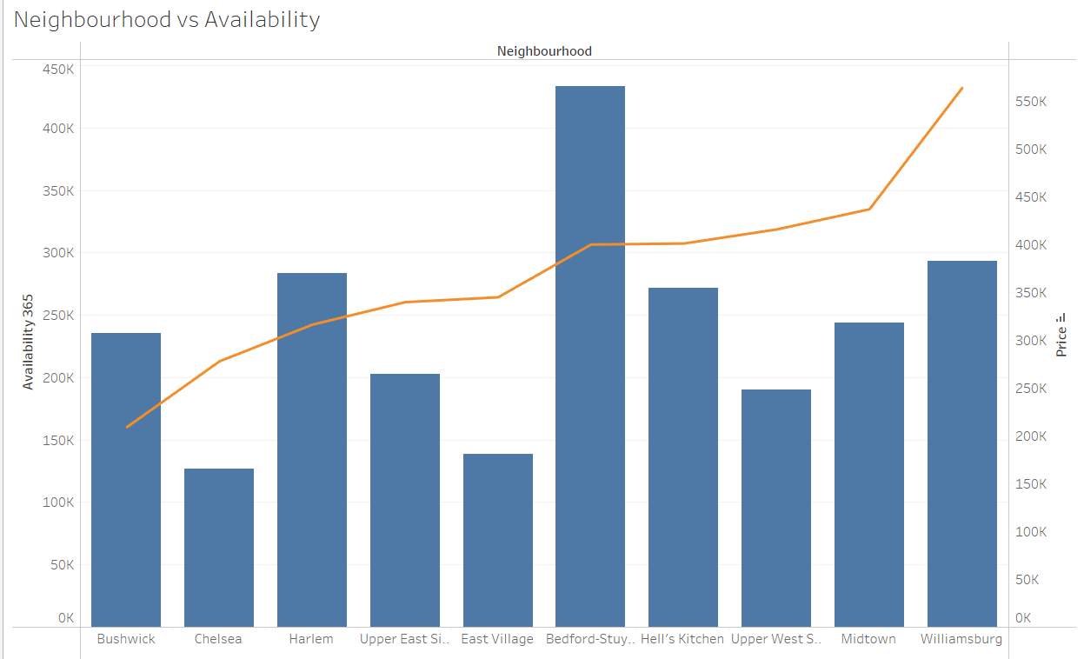
Community vs Accessibility
Bedford has the greatest availability and relatively low prices, making it a favorable option for customers.
Following Bedford, Harlem exhibits a similar pattern.
Chelsea has limited availability but comes with a higher price tag.
Conversely, William's pricing is high, and its availability is average.

Slide 11
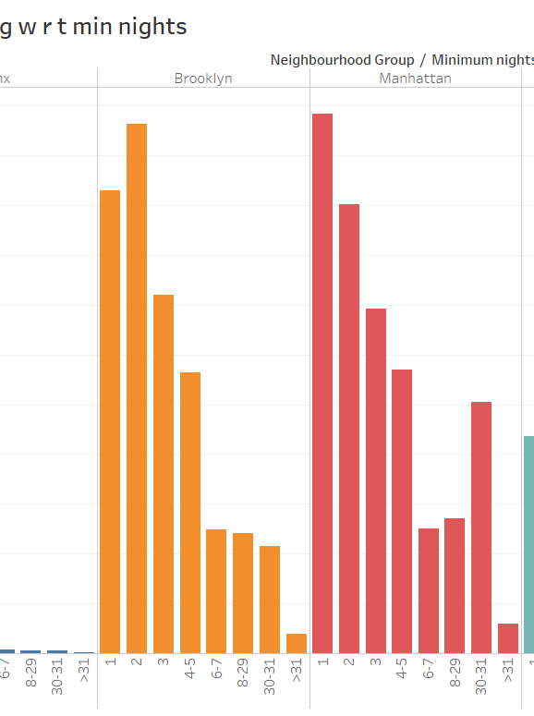
Customer Reservations Regarding Minimum Night Stays
Listings with minimum night requirements of 1-5 attract the highest volume of bookings. Notably, there is a significant increase in bookings for 30 days, likely indicating that customers prefer renting monthly.
Beyond the 30-day mark, minor spikes in bookings can also be observed, which may be attributed to the trend of monthly rentals.
Both Manhattan and Queens show a greater number of 30-day bookings compared to other areas. This might be due to tourists opting for longer stays or mid-level employees seeking affordable accommodations during business trips.

